Slide 1

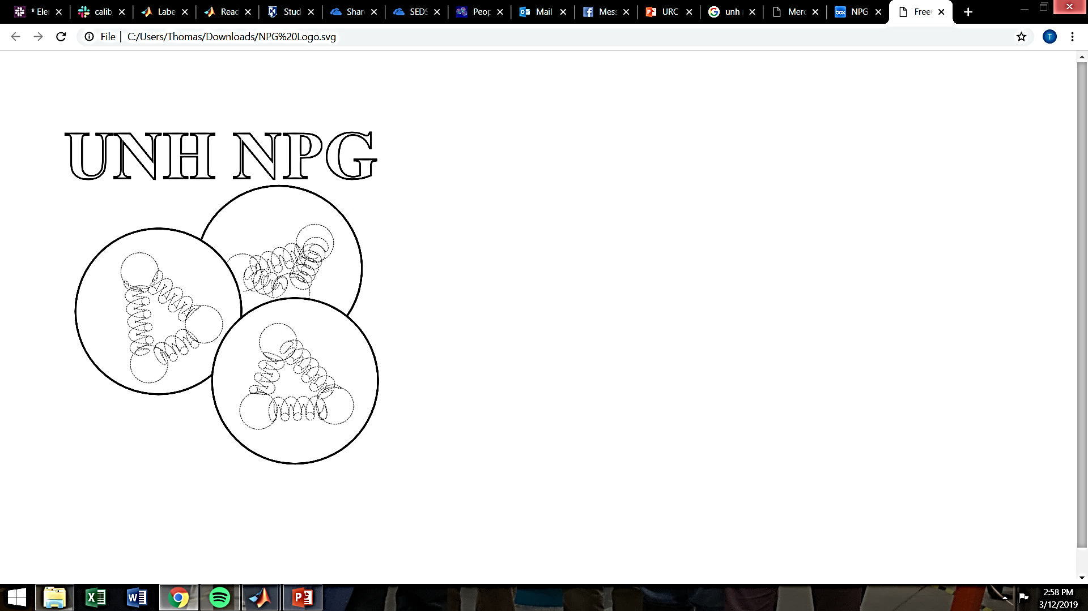
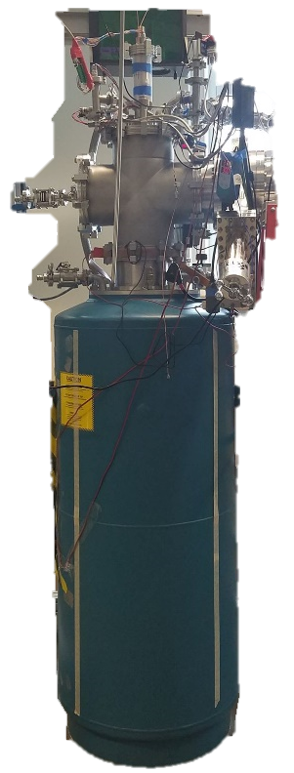
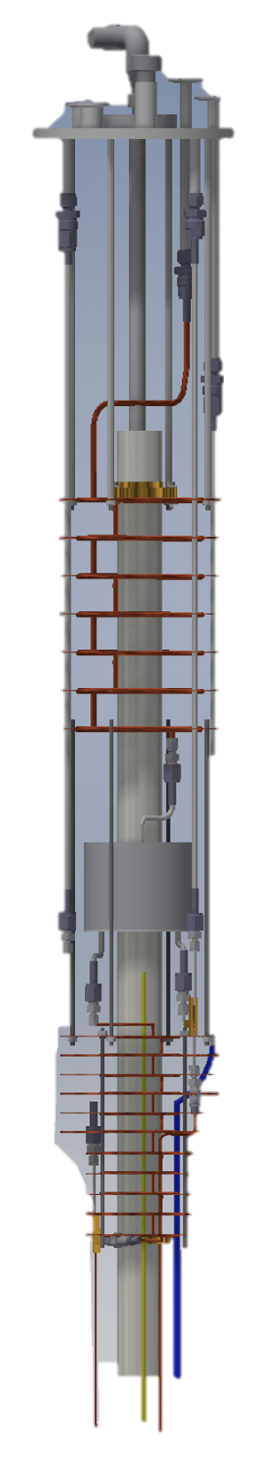
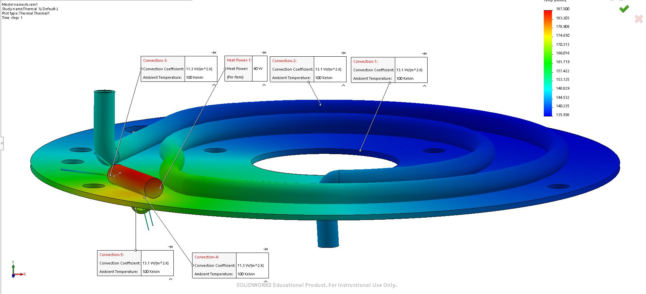
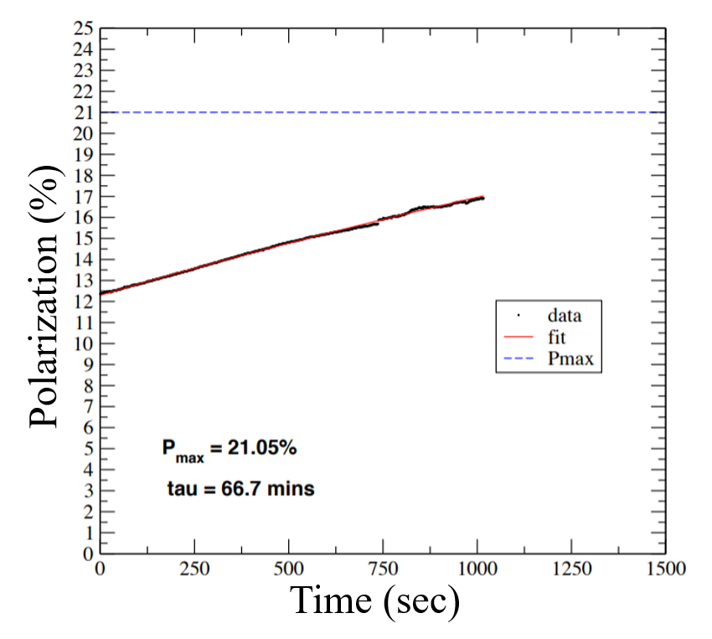
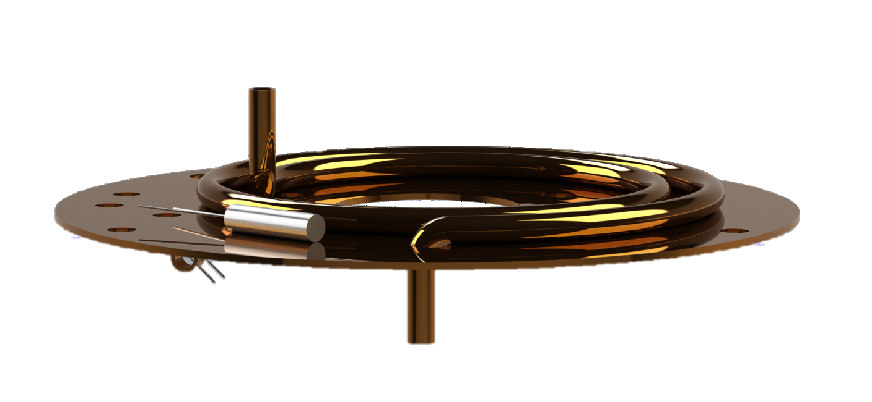
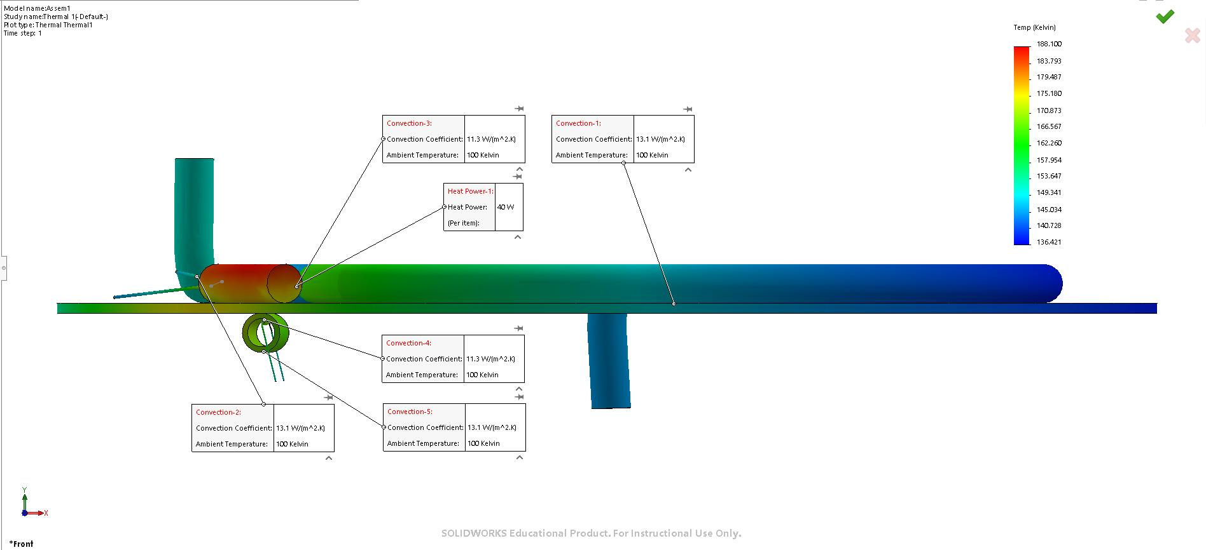
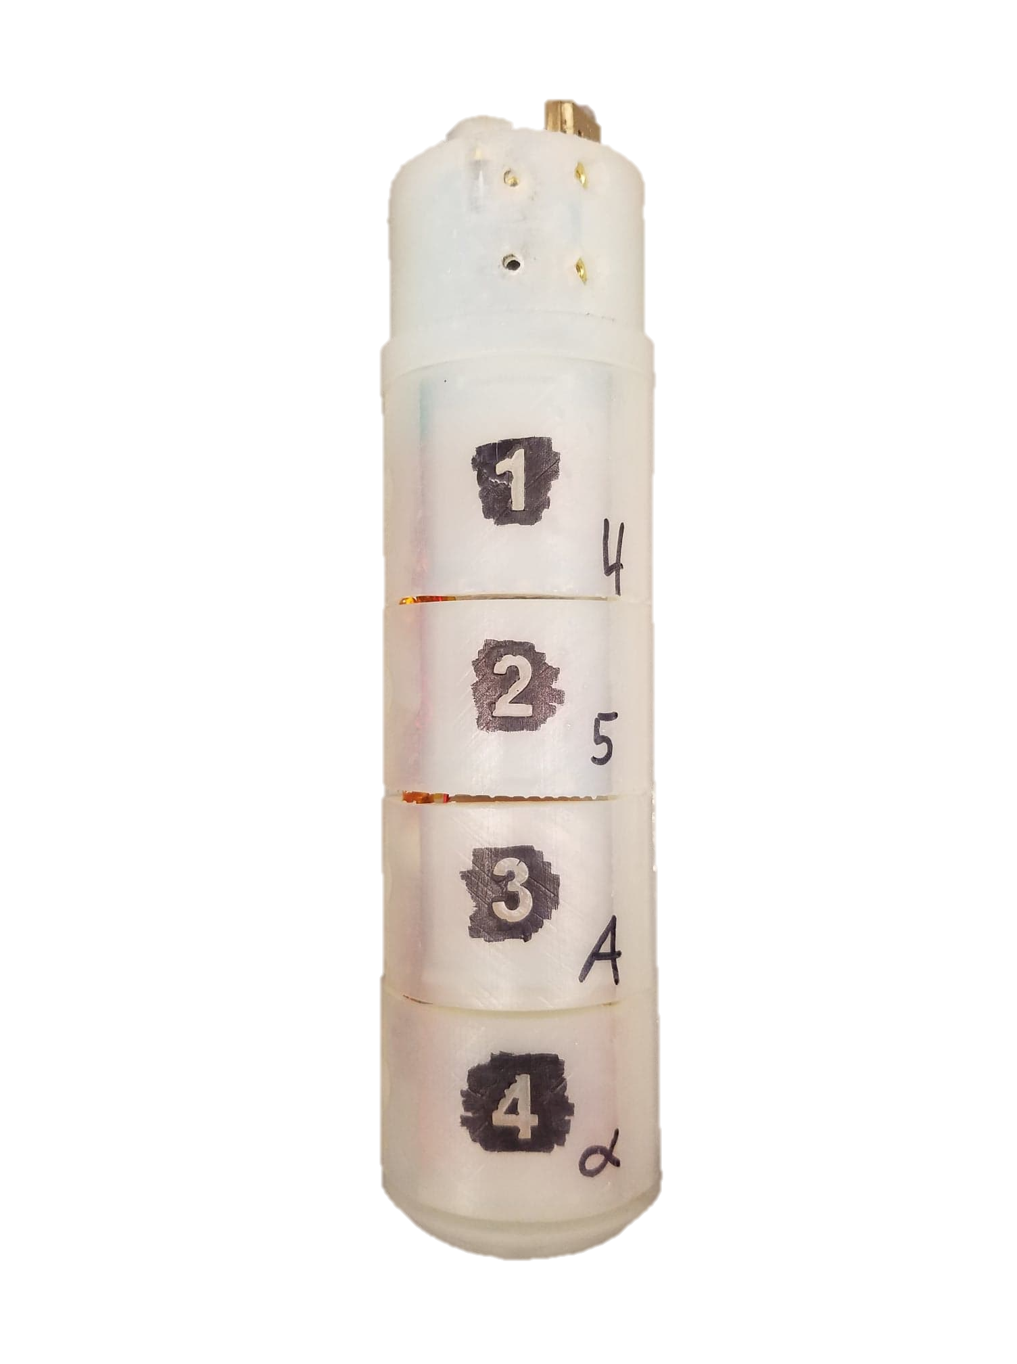
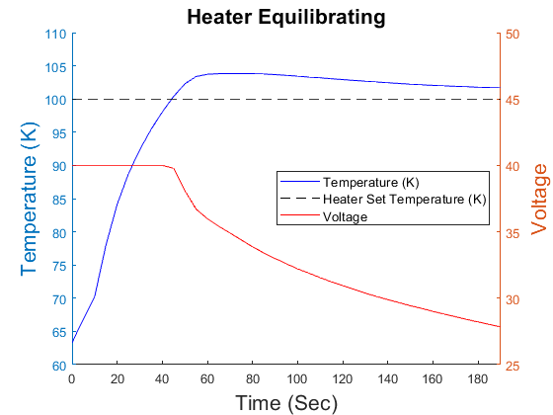
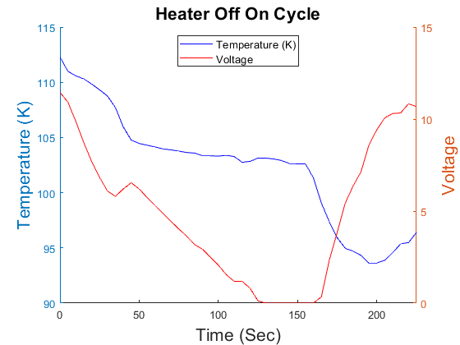
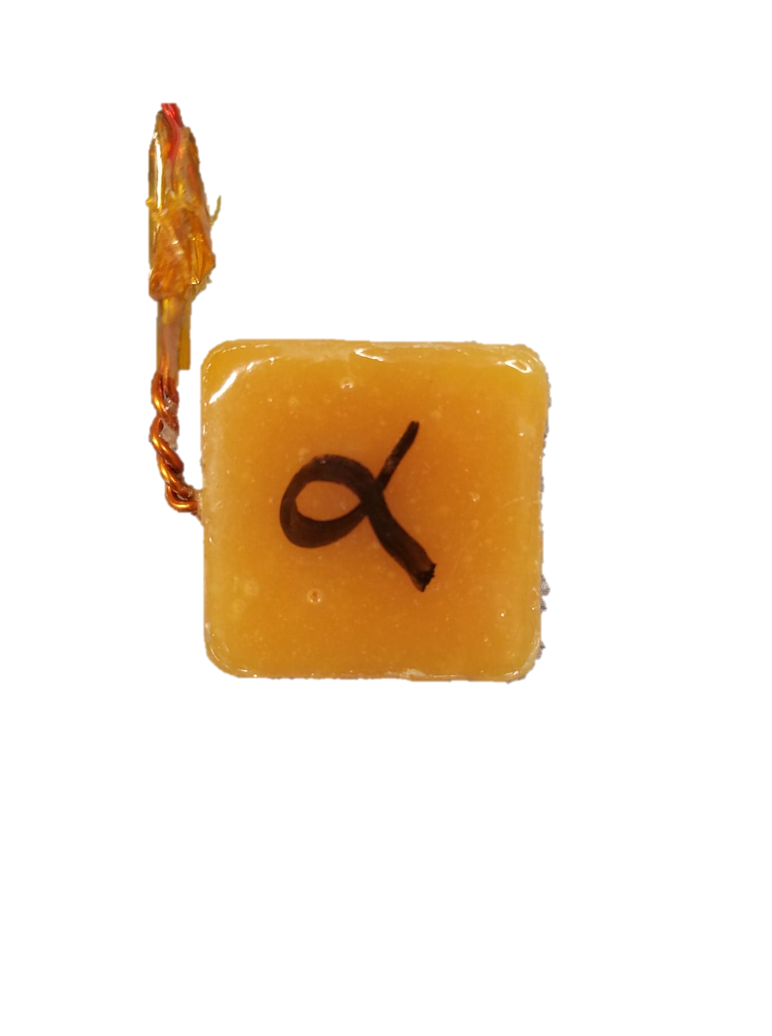
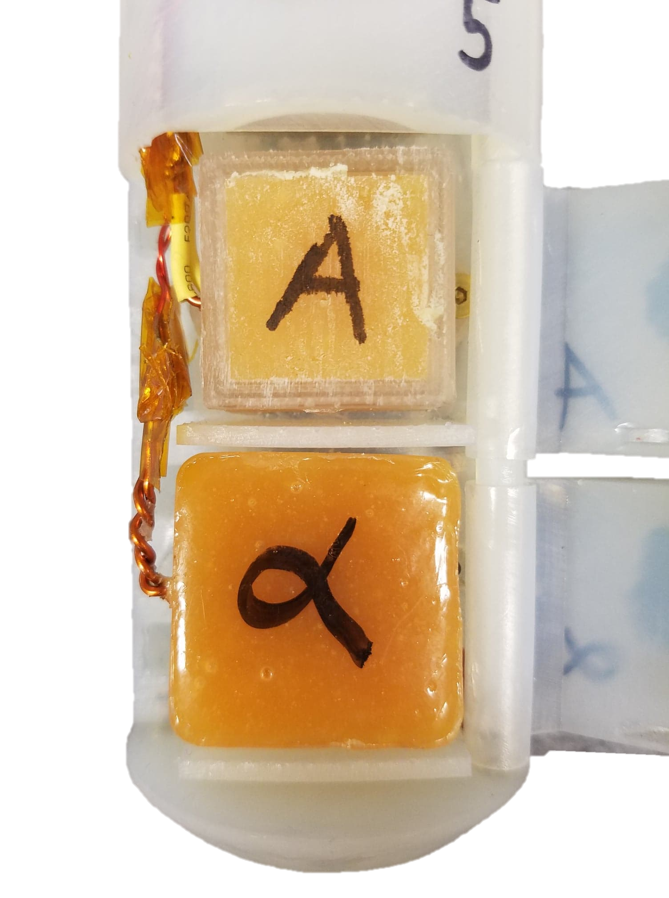
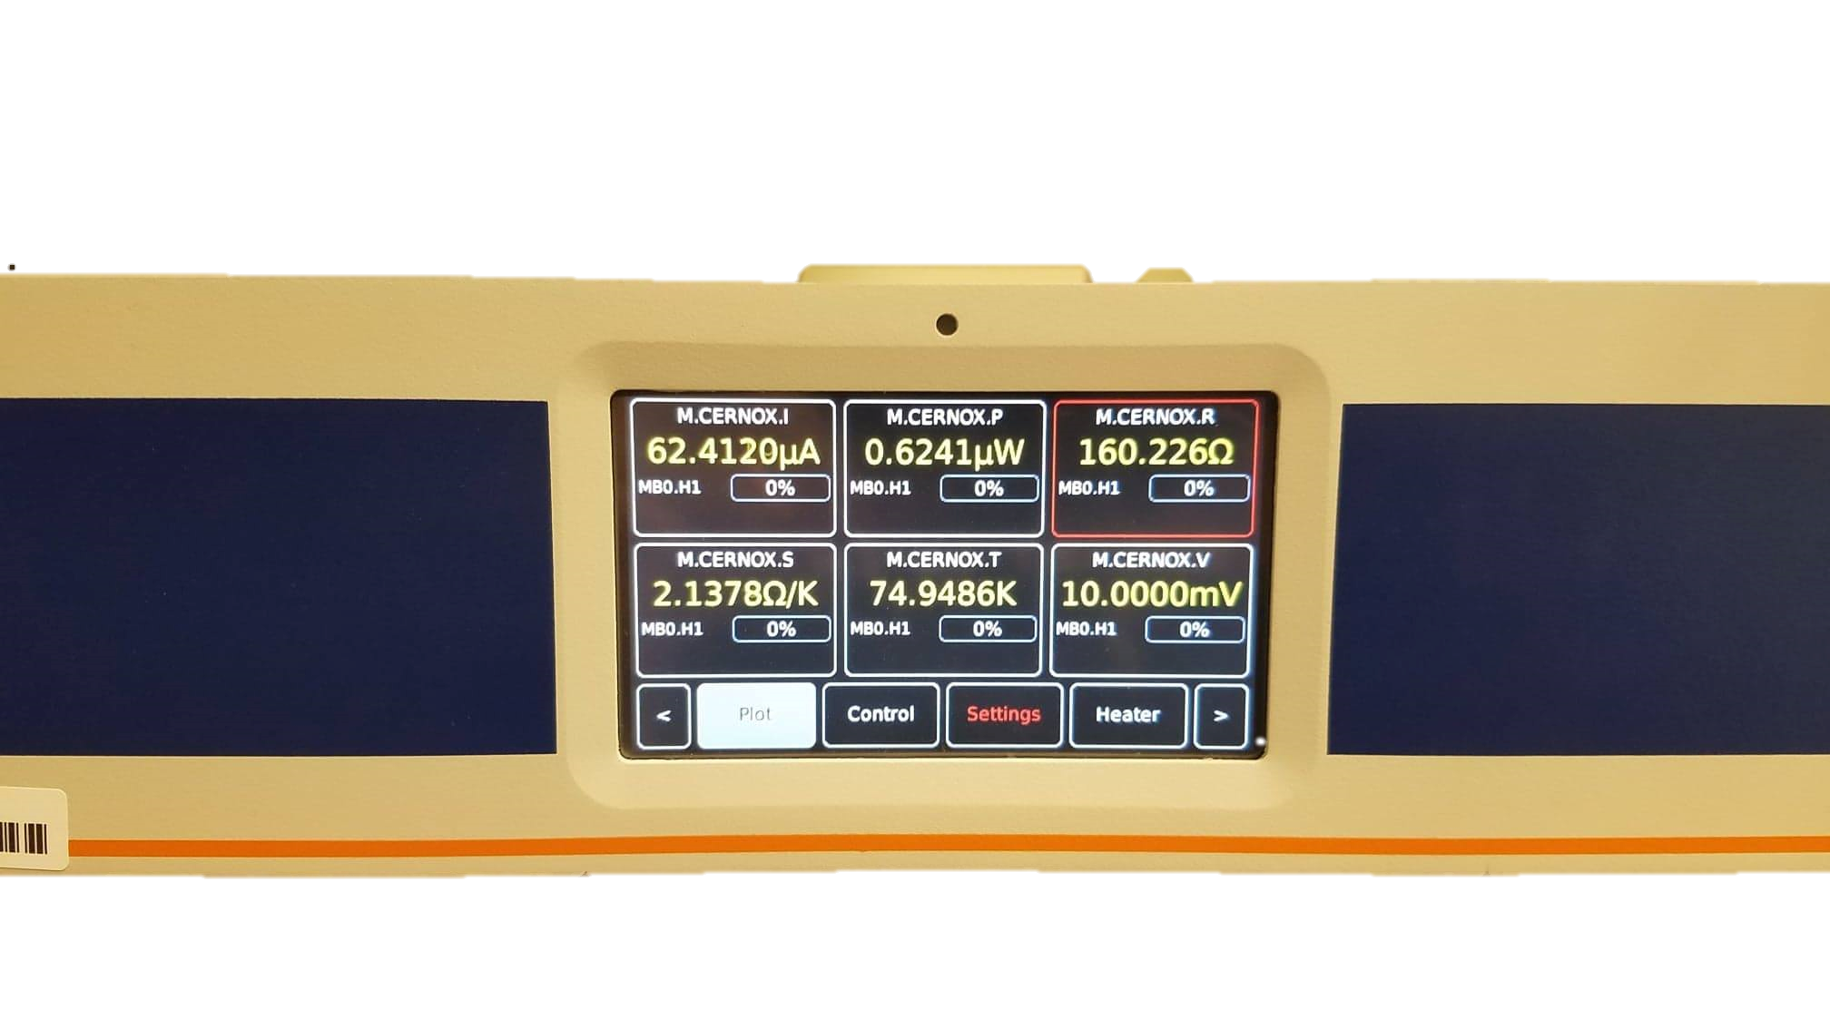
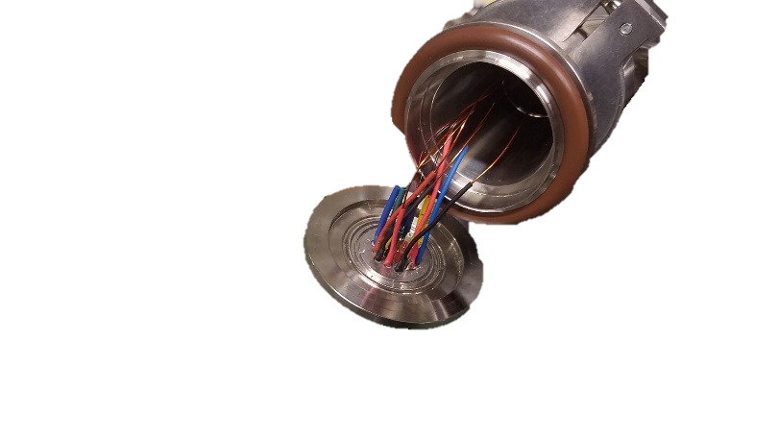
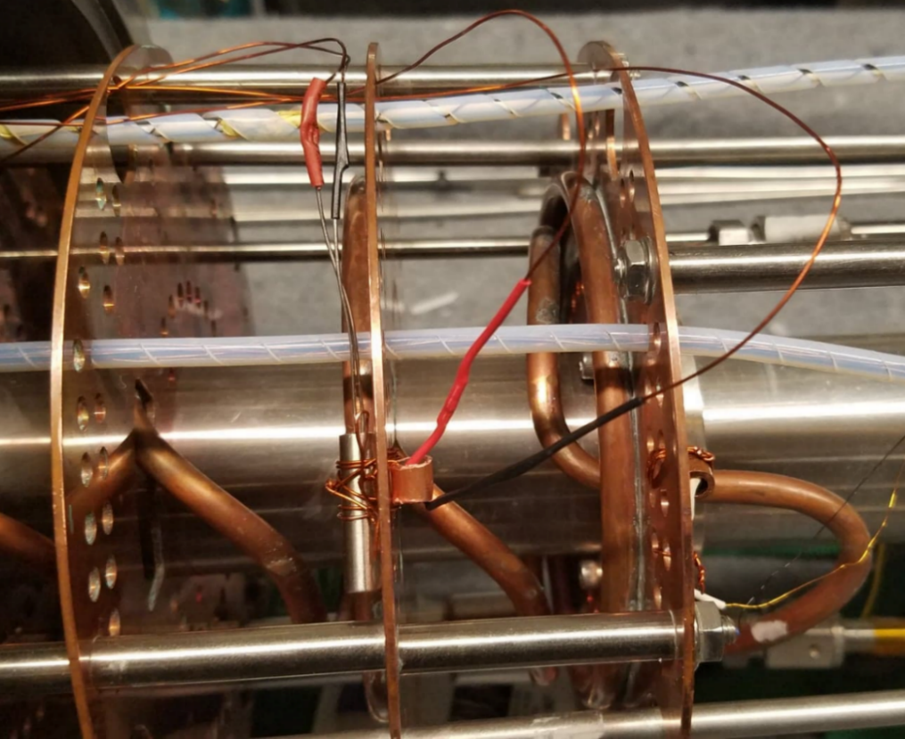
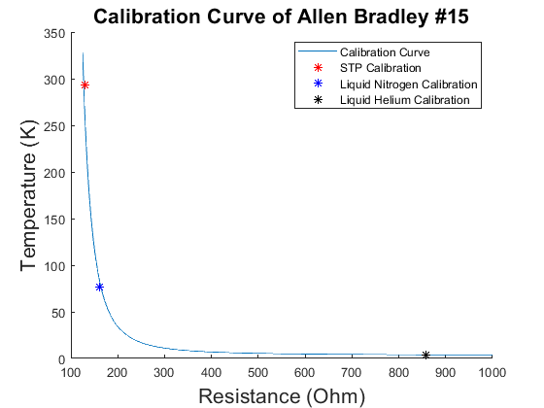
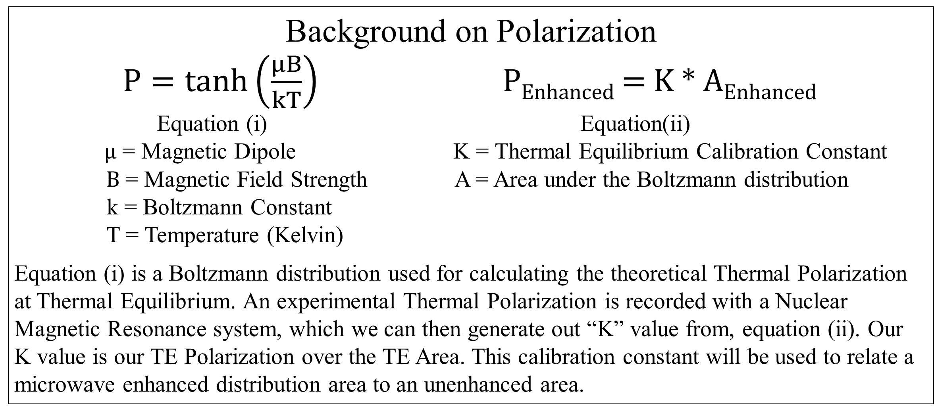
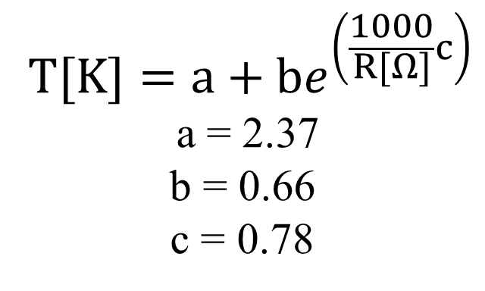
Polarization of Tempo Doped Araldite and Temperature Regulation of a Liquid Helium Evaporation Refrigerator
Thomas Collins
Advisor: Professor Karl Slifer
Background
My research at Professor Karl Slifer’s Polarized Target Lab was to test polarizable proton rich target material for use in our DNP polarizer (left side). Secondly, to implement a PID feedback system to regulate the temperature of the liquid helium evaporation refrigerator. This was critical to avoid overcooling which can compromise O-ring seals and lead to catastrophic failure of the protective vacuum (right side). A deconstruction of the DNP polarizer is seen below.
Motivation
Araldite Epoxy doped with TEMPO has been found to be a suitable target material for Dynamic Nuclear Polarization. A maximum proton polarization value of 21.05% percent has been achieved with a magnetic field of 4.998T and a temperature of about 1.2 K. Secondly, I installed and modeled a heating cartridge into the fridge assembly to control the temperature of the fridge and prevent overcooling.
Magnet and Fridge Assembly
Background on Polarization
$P=\tanh\left(\frac{μB}{kT}\right)$ P_{Enhanced} = K * A_{Enhanced}
Equation (i) Equation(ii)
$μ$ = Magnetic Dipole K = Thermal Equilibrium Calibration Constant
$B$ = Magnetic Field Strength A = Area under the Boltzmann distribution
k = Boltzmann Constant
T = Temperature (Kelvin)
Equation (i) is a Boltzmann distribution used for calculating the theoretical Thermal Polarization at Thermal Equilibrium. An experimental Thermal Polarization is recorded with a Nuclear Magnetic Resonance system, which we can then generate out “K” value from, equation (ii). Our
K value is our TE Polarization over the TE Area. This calibration constant will be used to relate a microwave enhanced distribution area to an unenhanced area.
Fridge Assembly
Thermal Analysis of the Heating Cartridge
Post cooldown, a thermal analysis of the heating cartridge was done to observe its effect on the baffle and copper coil tubing. In this analysis, the ambient temperature was chosen to be 100K, and the heater power is set to 40W. These characteristics and the thermal coefficients for each part ensured an accurate representation.
Heating Cartridge and Thermometry SOLIDWORKS rendering of the heating cartridge and Allen Bradly thermometry assembly. Located On the second baffle above the separator.
Tempo Doped Araldite Spin Up
Post cooldown an analysis of our target polarization was done to determine our maximum polarization. Through analysis of our cryostat environment, magnetic field strength and other factors we determined that our polarization would have reached a maximum of 21.05% if our study had continued. Although 21.05% polarization is an great baseline achievement, we have yet to reach the 80% theoretical polarization stated in the literature. Additionally, a comparison between theoretical and experimental tau shows that we are taking too long to reach our P_{max}, we should expect to see a value between 25-30min.
Tempo Doped Araldite Target
Target stick containing the A and Alpha target in 3rd and 4th cups. Located on the end of the target ladder on the bottom of the fridge.
Heater Cartridge Performance
The following graphs consist of experimental data of the temperature response of the LHe radiation baffle to the heater cartridge.
P_{max} = Maximum Polarization
tau = Experimental Time Constant
Tempo Doped Araldite Targets
I mixed with 1:200 part Araldite Epoxy. This allowed us to create free form polarization targets with a magnet wire coil centered in the material. The small Tempo admixture provides the paramagnetic radicals necessary for dynamic nuclear polarization technique.
Heater equilibrating to a set point temperature of 100 K.
Heater cycle from an off state to an on.
Mercury iTC
A Mercury iTC is a cryogenic programmable intelligent temperature controller. This was used to monitor temperature and resistance, while controlling the heating cartridge though a set temperature or heat flow (%).
Heating Element
19 Pin Connection
A D9 connector ran from the
back of the Mercury iTC to the
19 pin connector. A 19 pin connector was used for electrical connections between the lab
space and the vacuum environment.
Heating Element
The heating cartridge and Allen Bradley resistor separated by a copper baffle. Wiring consisted of magnet wire and spade clips connections.
Low Temperature Thermometry
Reference
Noda, Yohei. "Thermosetting polymer for dynamic nuclear polarization:Solidification of an epoxy resin mixture including TEMPO." Elsevier. 09 Dec. 2014. <https://reader.elsevier.comAE/reader/sd/pii/...>.
An Allen Bradley Resistor was used to calculate the temperature inside the fridge. Allen Bradley Resistors are Negative Temperature Coefficient resistors, meaning they exhibit an exponential increase in resistance in low temperatures.
$$T[K]=a+be^{\left(\frac{1000}{R[Ω]}c\right)}$$
a = 2.37
b = 0.66
c = 0.78
Future Works
Integrate the heating cartridge into the preexisting LabVIEW data stream.
Optimize the placement of the heating cartridge to maximize effectiveness.
Investigate and improve DNP System to achieve 80% Polarization
Acknowledgements
A huge thank you to Karl Slifer, Elena Long, David Ruth, Nathaly Santiesteban, and all the members of Slifer and Long Lab.

